Slide 2


Slide 3
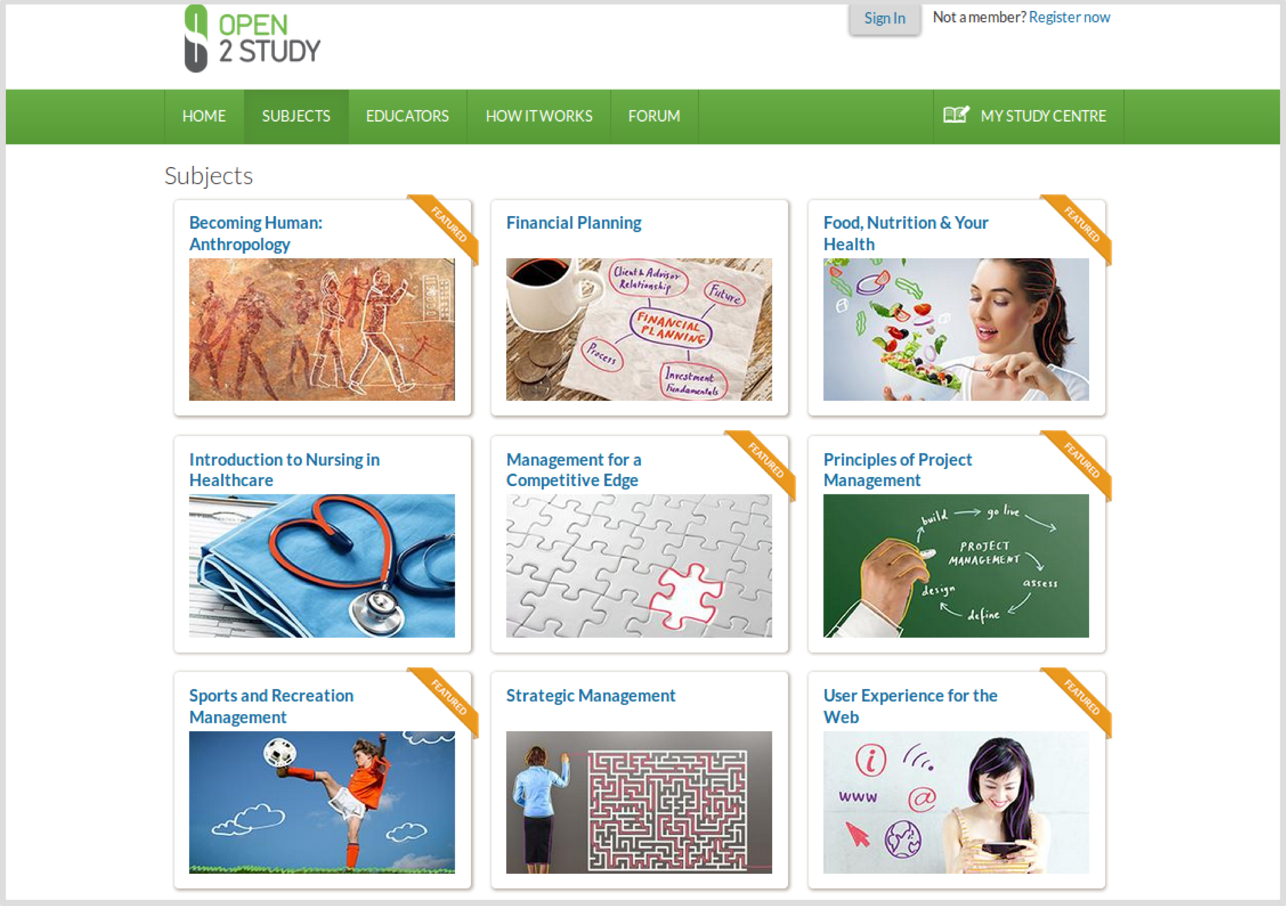
www.open2study.com a MOOC, Drupal/Moodle
Notes:
Everyone in this room (or at the least each organisation represented here today) has either attended the Koha user day, or attended another Koha demo at some stage.

Slide 4
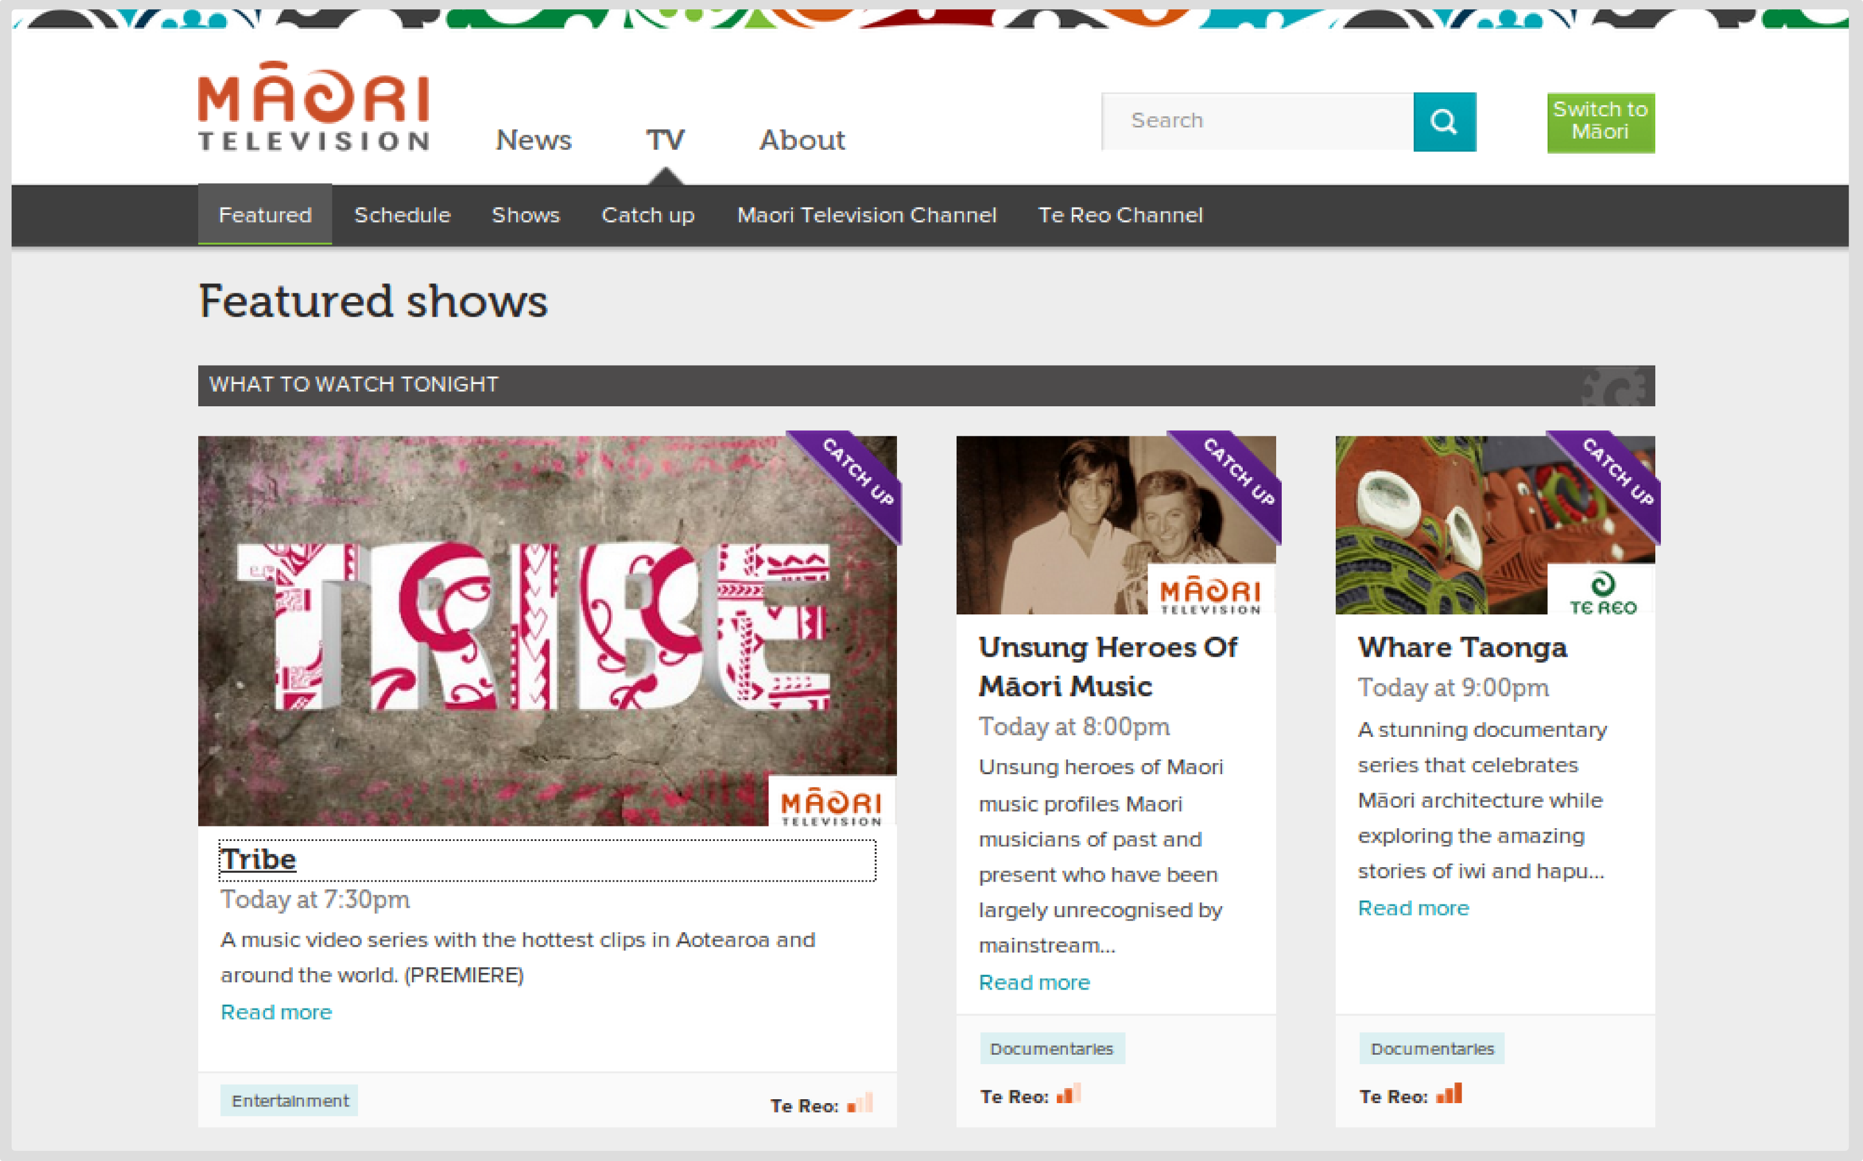
Maori Television Drupal Website
Notes:
Guy Reynolds
Department of Corrections
Brent McIntyre
Parliamentary Library
Gabrielle Hikaka
Te Puni Kōkiri/Ministry of Maori Development
Jean McCracken +1
Statistics NZ
Rachel Asi and Maria Nagelkerke
Dept of Internal Affairs
Ursula Clarke
Ministry of Business, Innovation and Employment (MED)
Diana Maunder, Sarina Sircombe
National Assessments Bureau - Dept of the Prime Minister and Cabinet
Tim Hannah and Hilary Rendell (Current Clients)
Ministry of Education
Hannah Benbow +3 (Current Clients)
Central agencies shared services centre - Koha for Treasury, SSC and DPMC (but not National Assessments Bureau)
Reserve Bank of NZ (Current Clients)
Raewyn Peters

Slide 5
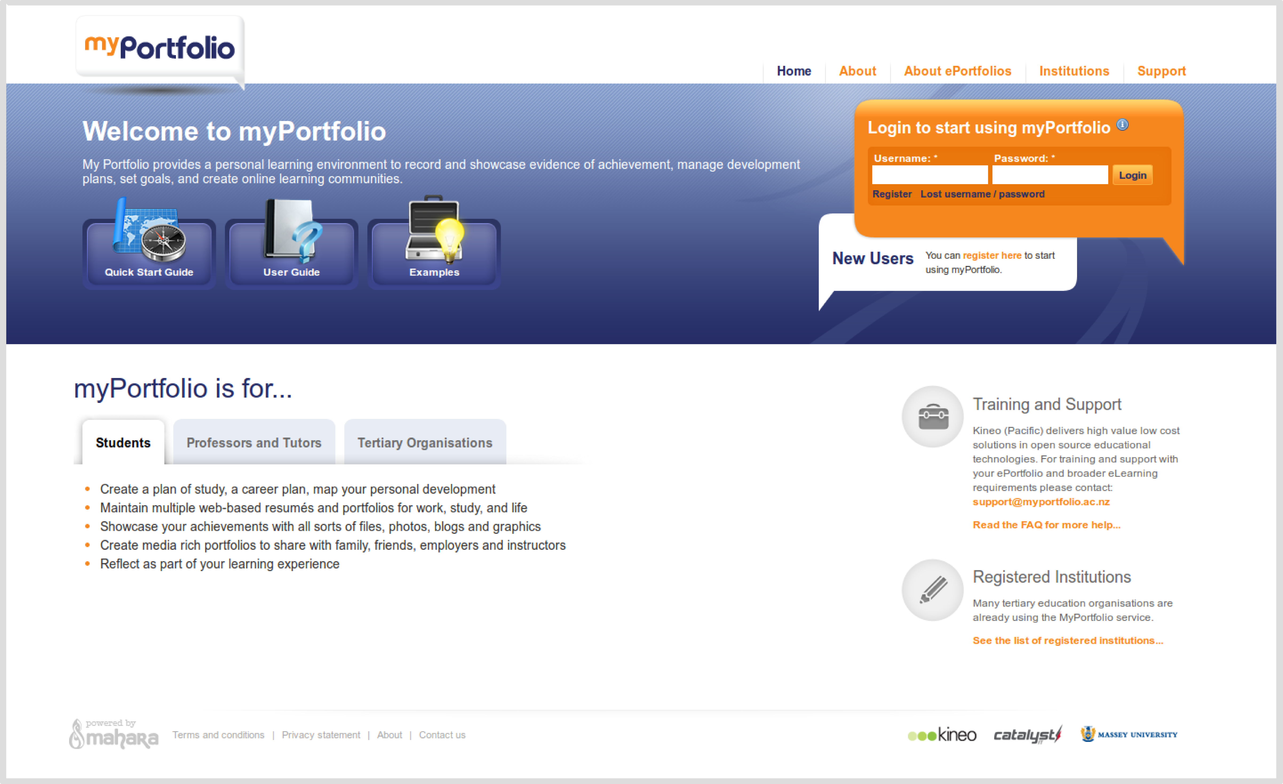
myportfolio.ac.nz Mahara e-portfolio

